Slide 1
The outputs of a data science experiment
Brian Caffo, Jeff Leek, Roger Peng
@bcaffo
www.bcaffo.com

Slide 2
Output
Some of the most common output from a data science experiment
Reports
Presentations
Interactive web pages
Apps

Slide 3
Reports
Ideally reports given to you will be
Clearly written
Involve a narrative around the data
Creation of analytic dataset
Analysis
Concise conclusions
Omit unnecessary details
Reproducible

Slide 4
Presentations
Same exact criteria for presentations:
Clear
Involve a narrative around the data
Creation of analytic dataset
Analysis
Concise conclusions
Omit unnecessary details
Reproducible

Slide 5
Interactive web pages
Apps and web pages
Easy to use
Help pages or documentation
Code should be documented well
Code should be version controlled

Slide 6
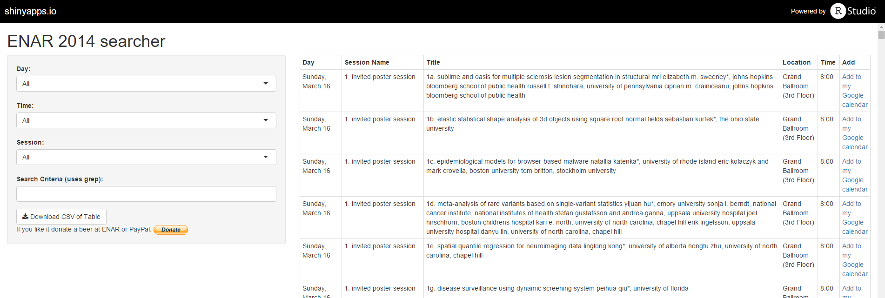
Example Apps and producs

Slide 7
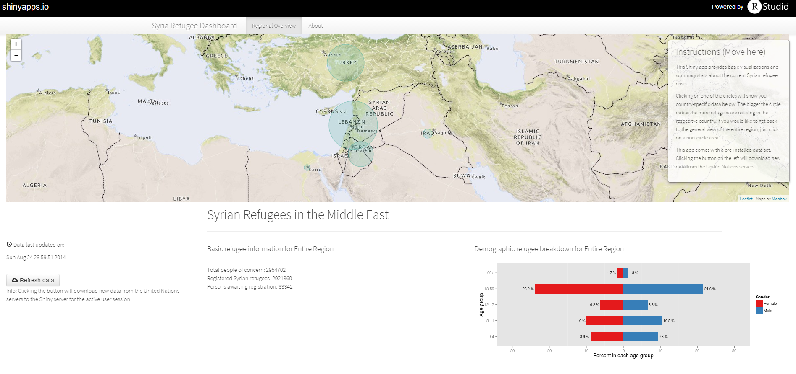
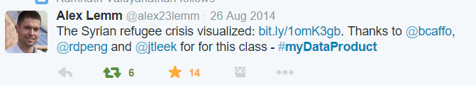
Syrian refugee crisis

